Slide 1
InfoCodex AG Semantic Technologies
Competitive Intelligence

Slide 2
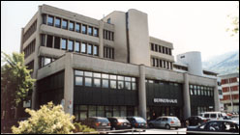
The Company:
15 Years Experience in Semantic Technologies
Swiss Software Company
Sector: ICT
Founded: 2002
Competences: Sem. Tech.
Headquarter: Buchs SG
Employees: 10 (in CH)
Originated from:
MSI Dr. Wälti AG founded 1981
with core competences in high performance databases (Widas) and data analysis.

Slide 3

Today‘s Information Management Problem
How can we manage the flood of information?
Electronically stored data growth 50 to 100% per year, i.e., doubling every 1 to 2 years
(International Data Corporation IDC, November 2010)
85% of the electronically stored corporate information is unstructured information
(IBM study, August 2005)

Slide 4
With its USPs, InfoCodex can handle this problem
● InfoCodex “understands” the thematic content,
across the language barriers, without training
● It can categorize/match documents according to
their content (building well organized bookshelves)
● It automatically generates abstracts and keywords
● It bundles similar documents into one family
→ reduction of volume without loss of information
● It finds and retrieves documents not only by
keywords, but also using text in natural language

Slide 5
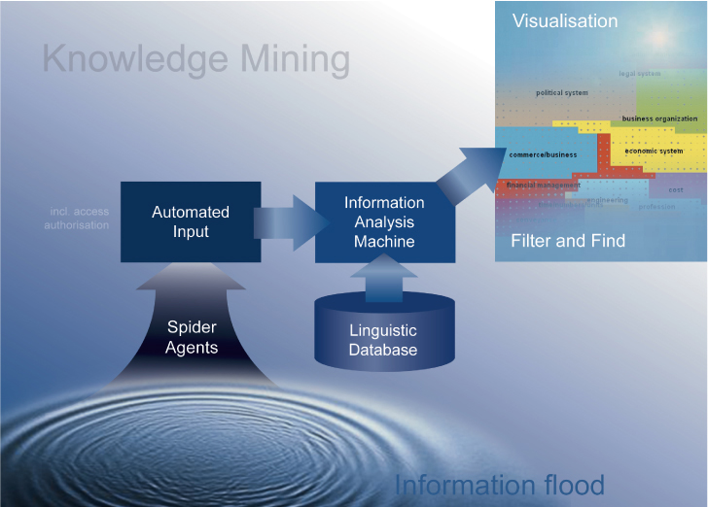
Technology Protected by Two Key Patents:
Semantics + Neural Networks + Statistical Analysis
The essential features
Unique, large Linguistic Database linked to a universal Taxonomy
(4 Mio items, en/de/fr/it/es)
Combined with linguistic and statistical analyses and neural networks
Patented in the EU and the USA

Slide 6
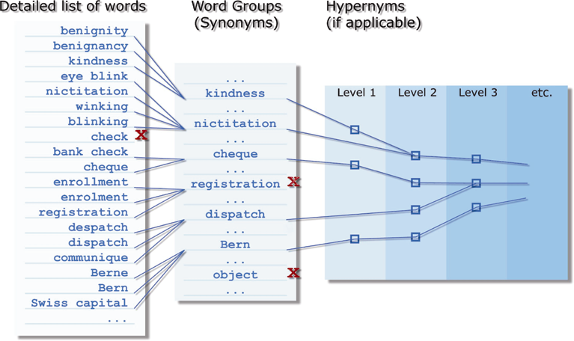
Basis for the Semantic Analysis: The Linguistic Database
> 4 Mio Items
EN/DE/FR/IT/ES
Taxonomy
7'000 Hypernyms / 7 Levels

Slide 7
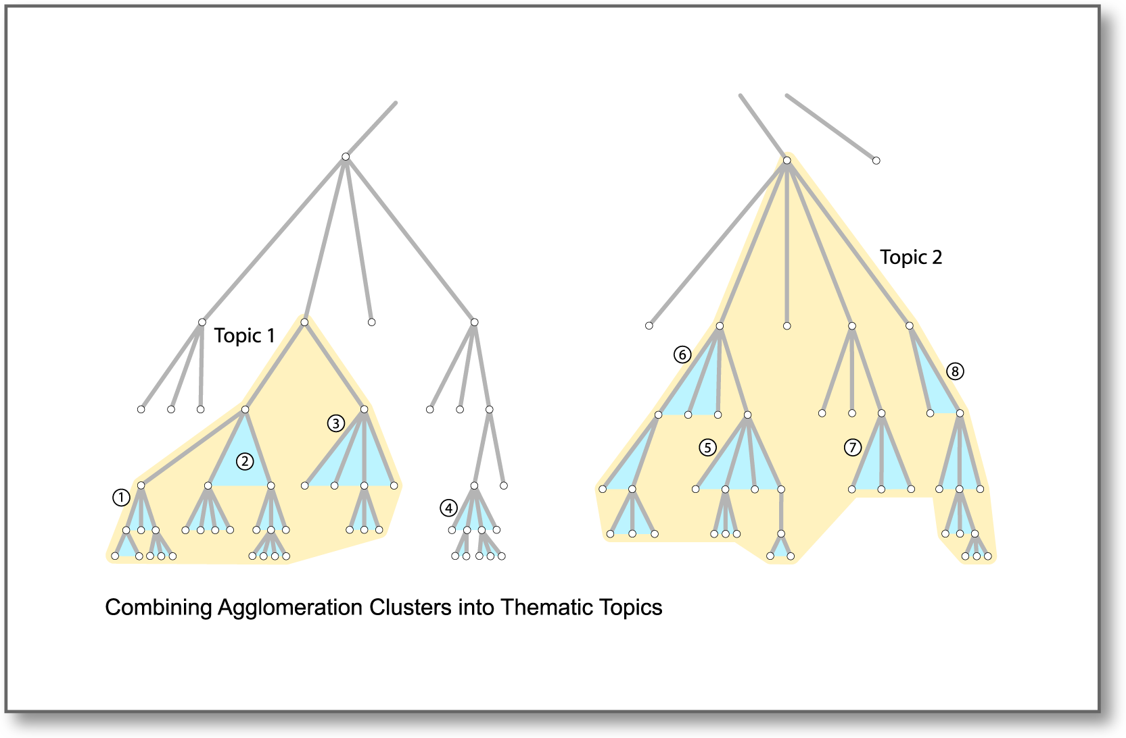
I. Characteristics and Functionalities
Clustering of Documents

Slide 8

This is what the Tool Should Do
Automatically read and analyze big amounts of unstructured (incl. structured) information, condense and summarize (“pre-digestion”)
Gathers and filters topic-specific info.
Structures the found information
Summarizes and condenses
Automatically search in selected internal and external sources
(e.g. Google)
Automatically group into characteristic categories/subtopics
Automatically provide meaningful document summaries
Recognizes prio-rities/relevances
Automatically rank articles based on their relevance
Presents/visualizes overviews/trends
Present summary in an easy to use tool
Categorization map can be automatic or user-defined
Condense docs with similar content into a single family
Interest-specific rankings by concept filters (prose text)
Eliminate irrelevant docs by concept filters
Heat and correlation maps; trend views
Graphical display of similarities etc.

Slide 9
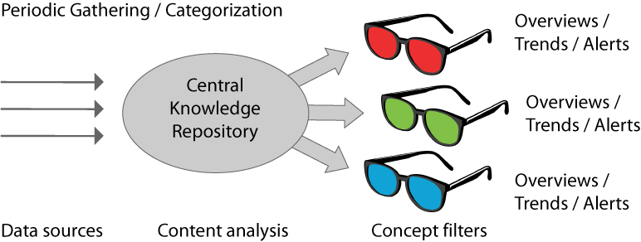
Concept for Market Intelligence
Spidering the Web and gathering data on competitors or on other fields of interest and making the relevant data available in an easy and accessible way.

Slide 10
Difficulties in the Market Monitoring
The true secret service scandal
NZZ , 25. Jan. 2014, Eric Gujer
“America's intelligence services are considered to be insatiable data leeches. But they drown in the flood of information that they no longer dominate. The benefits of their work is therefore often doubtful.”
→ “Not the gathering of information, but its analysis and evaluation is the real bottleneck.”

Slide 11
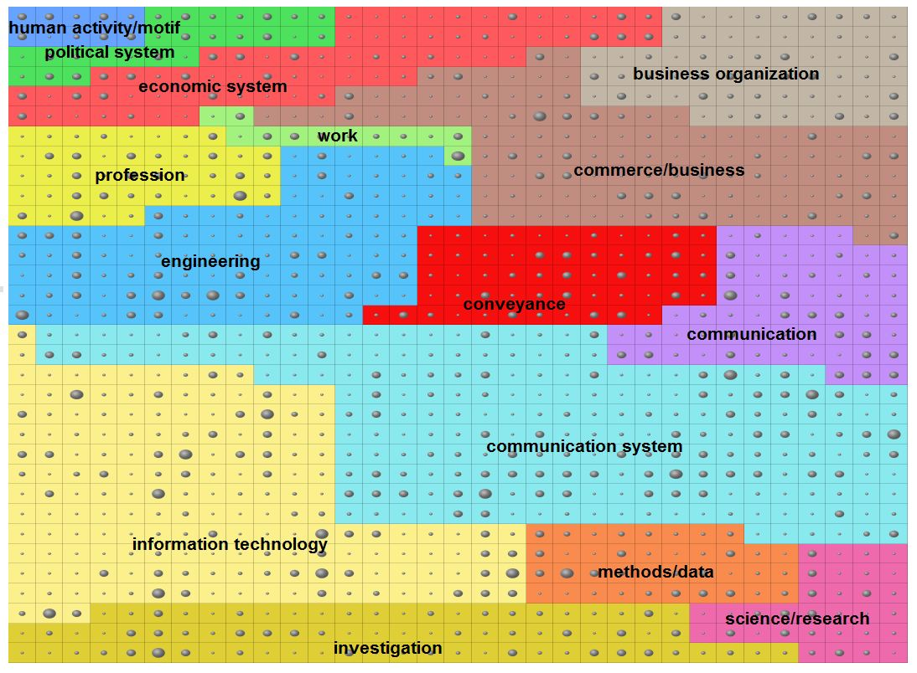
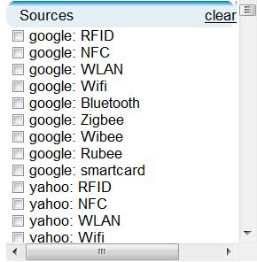
Market Intelligence: Information Sources
Overview the information flood
Define interesting data sources
Websites
Internet Databases
Search Engine Requests
RSS feeds
File servers
E-Mails
…
… and InfoCodex generates fully automatic a categorized overview of the content

Slide 12
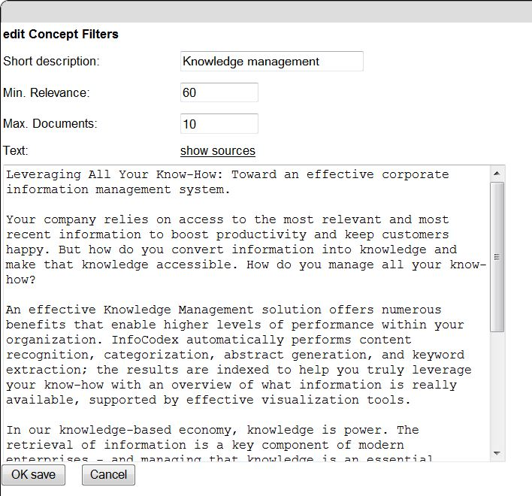
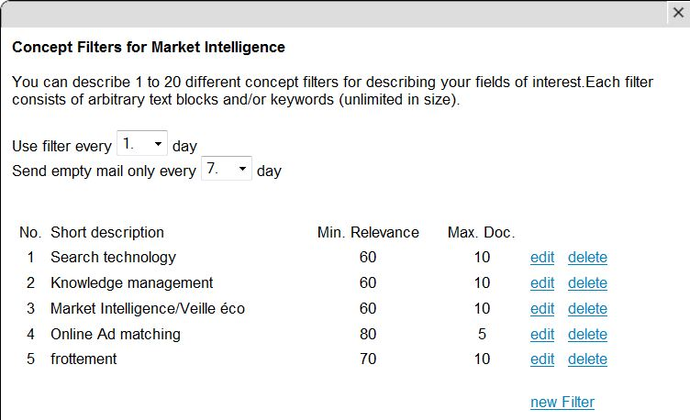
Market Intelligence: Concept Filters
Set your concept filters
Use a document describing your interests as concept filter
→ InfoCodex' similiarity search finds the relevant documents

Slide 13
Recognizing Current Web Pages
Ideal condition
Web pages have a date
Reality
99% of the Web pages don‘t have date (or show the artificially generated current date)
Solution with InfoCodex

Slide 14
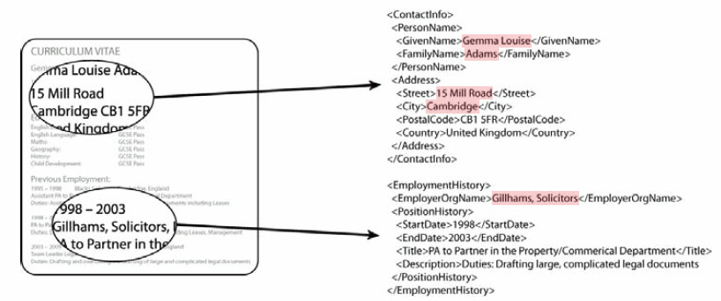
Extraction of Names and Codes

Slide 15
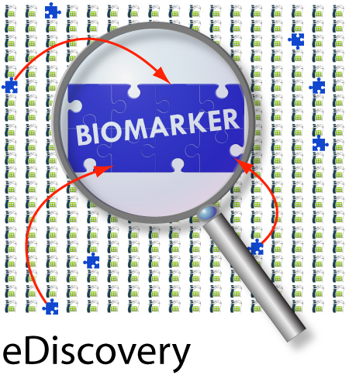
The Experiment of Merck & Co with InfoCodex
The objective:
► Test pure machine intelligence for
“semantic” drug research
The tasks:
► Discover novel biomarkers for diabetes
and obesity (D&O) by analyzing 120’000
medical publications (PubMed etc.)
► Blind experiment, no human feedback
Biomarker: $ 13.6 billion market in 2011, growing to $ 25 billion by 2016

Slide 16
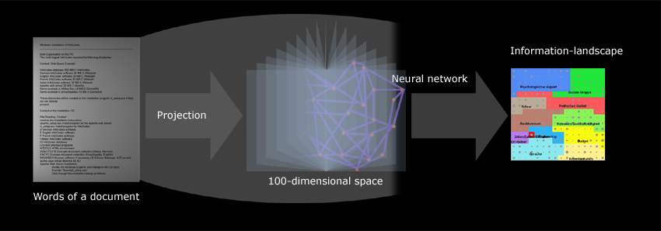
Knowledge Discovery in Large Sets of Publications
Keys to success:
Ability to categorize unstructured information
(in a benchmark, InfoCodex reached the very high clustering accuracy of 88%)
Advanced statistics: combination of unnoticed correlations
(the sentence-by-sentence analysis of the NLP approaches can detect only those
relations that have been written down by an author, i.e. that are already known)

Slide 17
What Makes the InfoCodex Approach Unique?
● Other approaches like NLP analyze documents
sentence by sentence
=> they can detect only relations that have been
written down by an author, i.e., that are already
known
● Discoveries of really novel relations base on a
combination of small, seemingly unrelated and
unnoticed facts dispersed over isolated publications
=> that’s what InfoCodex does, combining semantic
technologies with statistical and neural analysis of
whole document collections

Slide 18
Customer Benefits in Gaining Competitive Advantages
1. Targeted individual information sources with
identification of new (current) information
2. Alerts with relevant and new documents (thematic
relevance controlled by concept filters)
3. Early recognition of changes/trends

Slide 19
II. Technical Properties
System Architecture of InfoCodex
InfoCodex Web application
Client-(Web) applications
HTTP, AJAX
Connectors
PHP
Webservice
...
TCP/IP
XML
InfoCodex-API
- Multithreaded daemon
- InfoCodex-session processes
WitCC
WIDAS DBMS
Enbcapsulated high-performance DBMS

Slide 20
II. Technical Properties
Spider Agents for Document Import
File Server Common document formats such as MS Word,
and Web PDF, Excel, PPT presentations, PostScript, RTF,
TXT, HTML, XML, RSS, MSG, EML (in original or
zipped form);
other file formats for which an i-Filter is available
Mailboxes Outlook, Outlook Express, Thunderbird, Exchange
Server, Lotus Notes (including attachments of the
e-mails in original or zipped format)
MS SharePoint Standard interface available
DBMS/DMS Needs individual connectors (e.g. using ODBC)

Slide 21
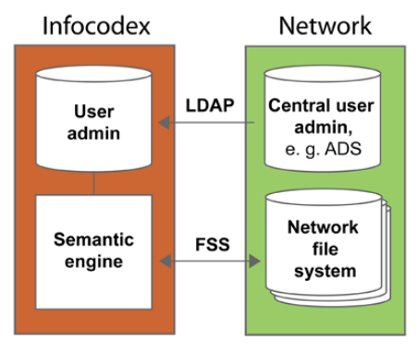
II. Technical Properties
Privacy and Security
▪ InfoCodex can be linked to the central user administration (e.g.
ADS) by the LDAP Protocol
▪ It fully respects the access rights given in ADS: File System Security

Slide 22

II. Technical Properties
Scalability
▪ The software implements multithreading
techniques and supports distributed
processing features.
▪ It allows the load to be spread across
a range of dedicated servers.
▪ The incorporated encapsulated DBMS is a purpose-built
a high-performance system.
▪ The size of the document collections is limited only by
the available hardware resources (64-bit software).

Slide 23

II. Technical Properties
International ICT Standards
Standards recognized and followed by InfoCodex:
▪ Web side: PHP, HTML, AJAX, HTTP,
HTTPS; W3C-Standards OWL, RDF etc.
▪ Web servers: Apache2 or IIS
▪ Programs: ANSI-C (GNU compiler),
C++, C#
▪ Interfaces: XML, SOAP, LDAP (for coordination with a
central user administration)
▪ Linguistics: WordNet of the the Princeton University,
EuroVoc, DIN and others

